Slide 1
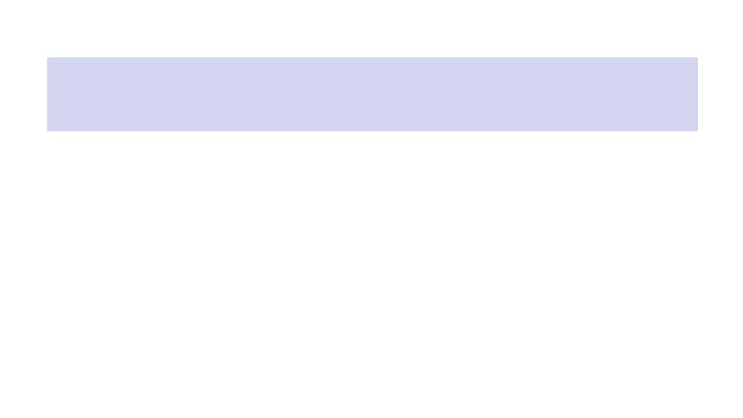
No Man’s Land
A custom SystemVerilog GPU and game on the DE1-SoC
Rohit Biswas Kambinachi Obioha Nicola Paparella
CSEE 4840 — Embedded System Design — Spring 2026
Instructor: Prof. Stephen Edwards

Slide 2
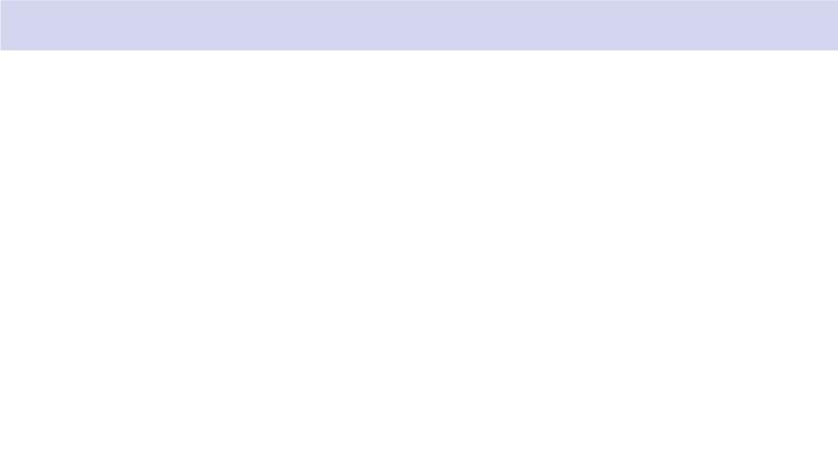
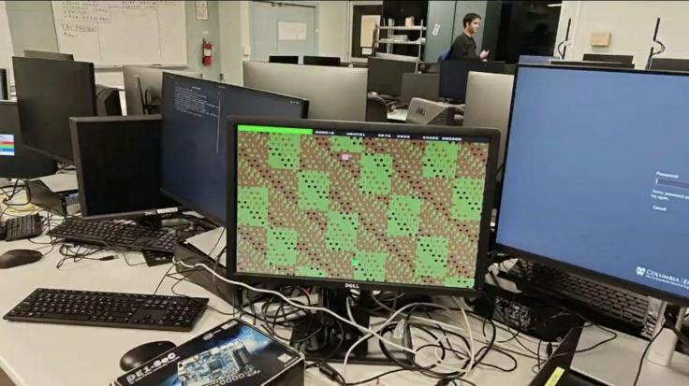
The system, running

Slide 3
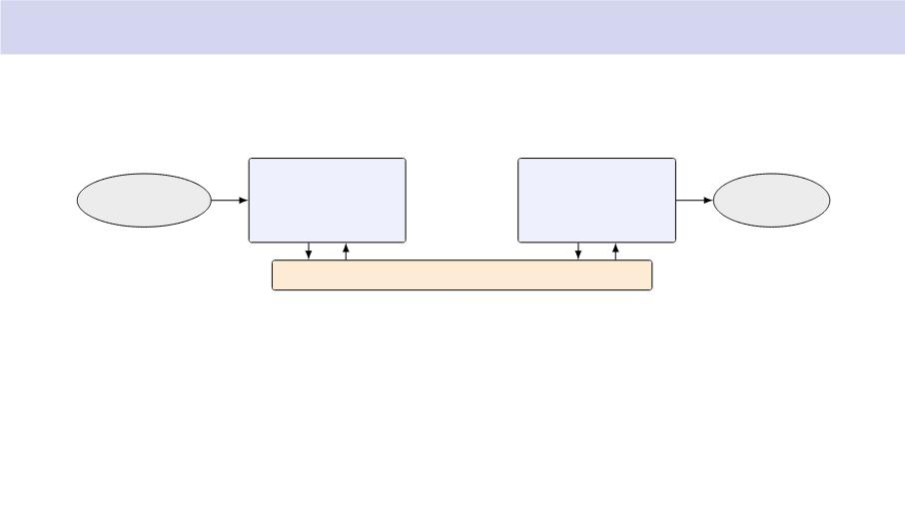
System block
HPS
FPGA fabric
nml_gpu
SNES gamepad
(evdev)
event0
(ARM Cortex-A9)
nml_game userspace
game loop @ 60 Hz
/dev/mem mmap
VGA out
VGA monitor
(24-bit RGB)
Avalon slave
sprite engine + compositor
25MHz pixel clock
Avalon-MM LW bridge 50MHz 32-bit data 14-bit byte address
HPS writes shadow state; FPGA latches at VSYNC; pixels always stream.
3/19

Slide 4
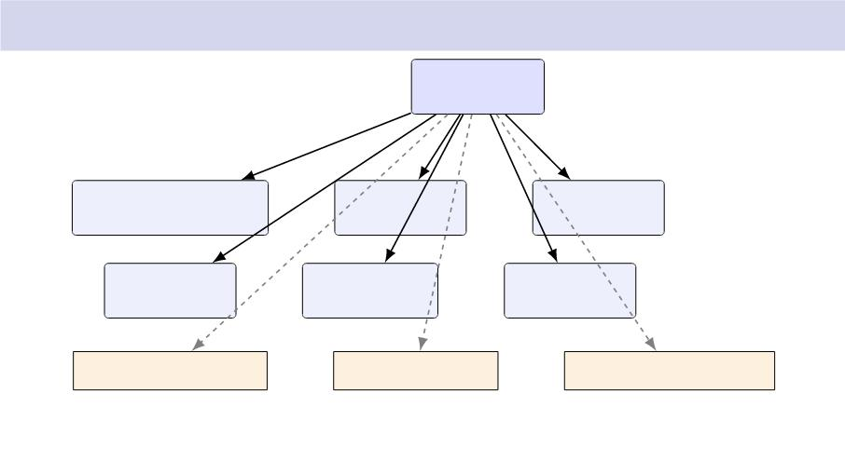
What’s inside nml_gpu
nml_gpu (top)
avalon_slave_iface
sprite_eval
pll_25mhz
vga_timing
sprite_fetch
compositor
sprite ROM, tile ROM
palette, tile map
sprite tables, line bu!ers
One 50 MHz domain (Avalon) + one 25 MHz domain (pixel). All RAMs/ROMs inferred as
M10K.
4/19

Slide 5
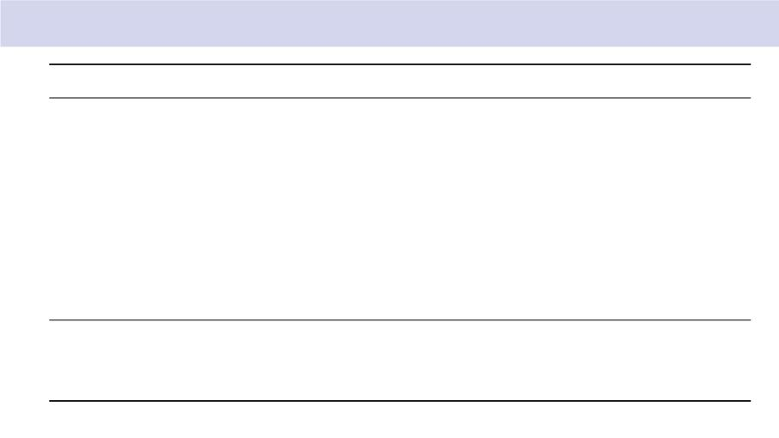
Avalon register map — 16 KB window at 0xFF200000
O!set
Name
Layout
0x0000
0x0004
0x0008
0x000C
0x0010
0x0014
0x0018
0x001C
0x0020
CTRL
STATUS
BG_SCROLL
IRQ_MASK
PLAYER_POS
[0]=ENABLE, [1]=SWAP (auto-clear), [2]=HUD_ON
[0]=VBLANK, [1]=SWAP_PENDING
[15:0]=scroll_x, [31:16]=scroll_y (signed)
[0]=VBLANK IRQ enable
[15:0]=px, [31:16]=py
PLAYER_STATS [7:0]=hp, [15:8]=wave (BCD), [31:16]=level
SCORE
KILL_COUNT
HUD_AUX
[23:0]=6-digit BCD score
32-bit kills
[7:0]=ammo BCD, [11:8]=art, [15:12]=gas
0x0100–0x01FF Sprite table
0x0400–0x07FF Palette
0x1000–0x22BF Tile map
32 entries → 8B
256 entries → 4B (RGB888)
80 cols → 60 rows, 1 byte/tile
5/19

Slide 6
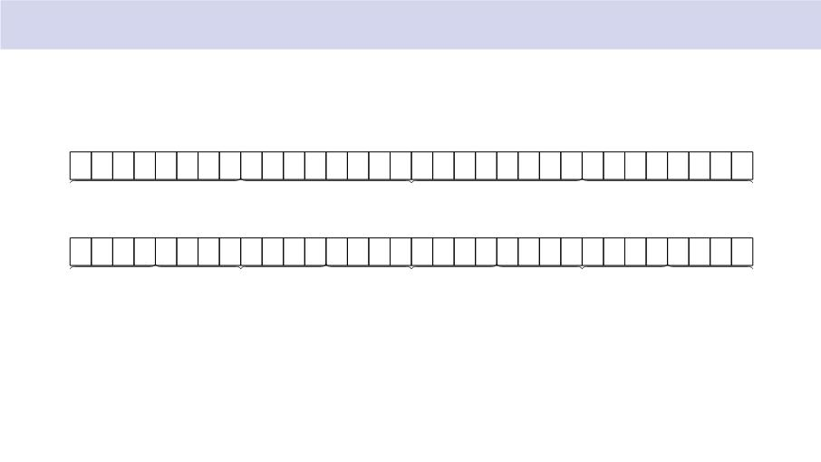
Sprite-table entry — 8 bytes / 64 bits
W0 (o!set 0x0)
x (signed 16)
y (signed 16)
W1 (o!set 0x4)
sprite_id
flags
palette_off
reserved
ﬂags byte: [2] hﬂip [3] vﬂip [6:4] priority (0 = highest) [7] ACTIVE
6/19

Slide 7
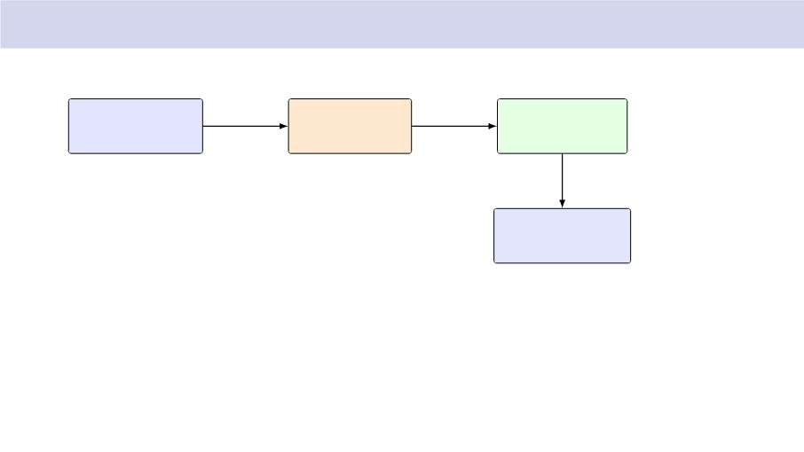
Frame commit — shadow ↑ active at VSYNC
CPU
pulse stretcher
3-FF synchroniser
(25MHz pix_clk)
edge detect
(50MHz clk)
7 50 MHz cycles
→
writes shadow + SWAP=1
(~140ns)
wait for vsync
bulk-copy 32 entries
shadow ↑ active
CPU then polls STATUS.SWAP_PENDING;
clears one cycle after the bulk copy.
One 20 ns Avalon pulse would slip past the 40 ns pixel clock. Widen to 140 ns and the CDC is
deterministic.
7/19

Slide 8
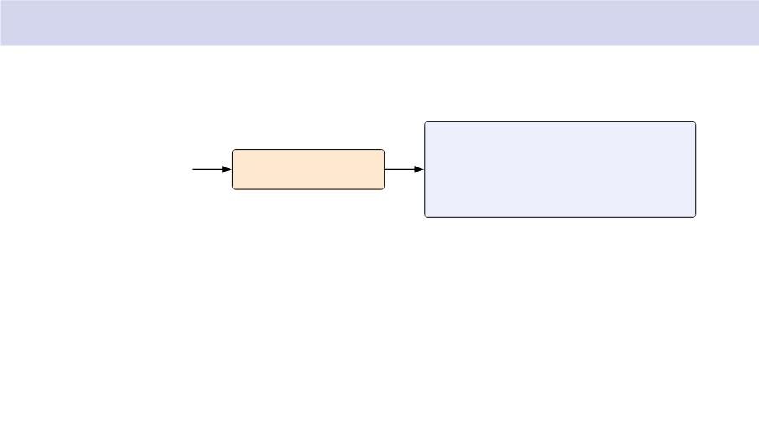
Tile-map byte writes — packed [3:0][7:0]
logic [3:0][7:0]
CPU STRB (1 byte)
LW bridge
tilemap_ram [0:1199]
avs_byteenable=0010
lane 0 | lane 1 | lane 2 | lane 3
only lane 1 writes; others held
Why packed? Byte-organised storage forced
bridge RMW to clobber 3 lanes per word.
Packed inference uses M10K byteena_a: one
lane updates, the other three are untouched.
8/19

Slide 9
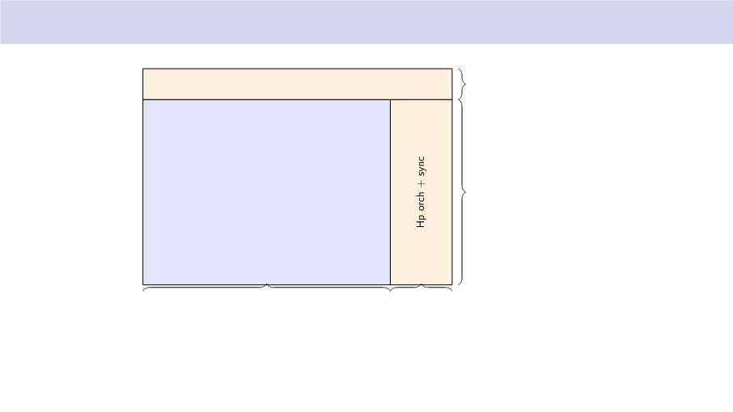
VGA timing — 640→480 @ 60 Hz, 25 MHz dot
V porch + sync
45 (FP 10, sync 2, BP 33)
visible 640 → 480
V_ACTIVE = 480
H_ACTIVE = 640
160 (FP 16, sync 96, BP 48)
One frame = 800 → 525 dot cycles. HBLANK is the 160-cycle window we use to evaluate
sprites for the next scanline.
9/19

Slide 10
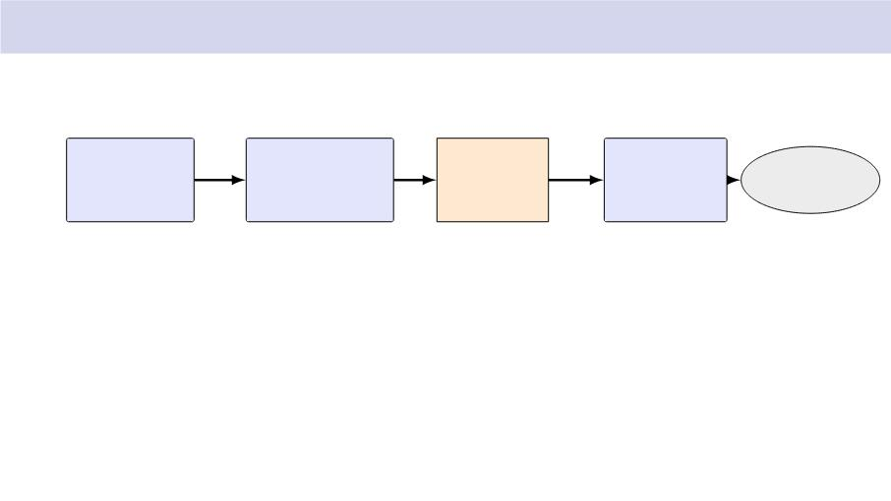
Pixel pipeline — sprite engine + compositor
sprite_eval
sprite_fetch
line bu!er
compositor
32-entry sort
CLEAR + ROM
(ping-pong)
4-stage pipe
VGA DAC
→65 cycles
→1024 cycles
640 ↑ 8 bit
tile + sprite
24-bit
RGB
per scanline
worst case
two banks
+ palette LUT
Eval runs inside HBLANK (160 cycles). Fetch spans HBLANK + visible (800 cycles).
Line bu!ers are double-bu!ered, so fetch lags read by one scanline. Compositor never stalls.
10/ 19

Slide 11
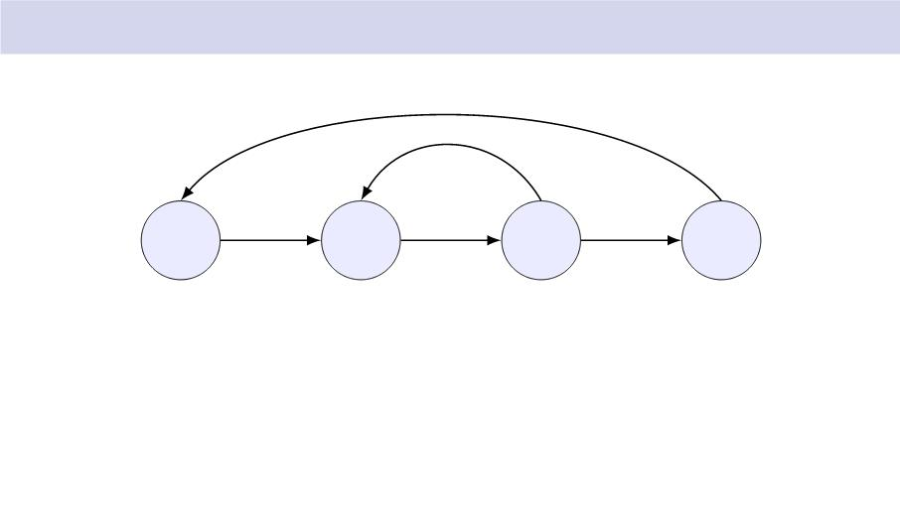
sprite_eval — per-scanline priority sort
latch & pulse
idx<31
eval_strobe
idx=31
IDLE
FETCH
EVAL
DONE
ROM read
Per sprite (1 cycle in EVAL):
intersects = active && y↓next_scanline < y+16
insertion-sort into 8 priority-ordered slots (all 8 compares in parallel)
Total: 32 fetch+eval cycles + 1 DONE = ↔65 cycles. Fits easily in 160-cycle
HBLANK.
11/ 19

Slide 12
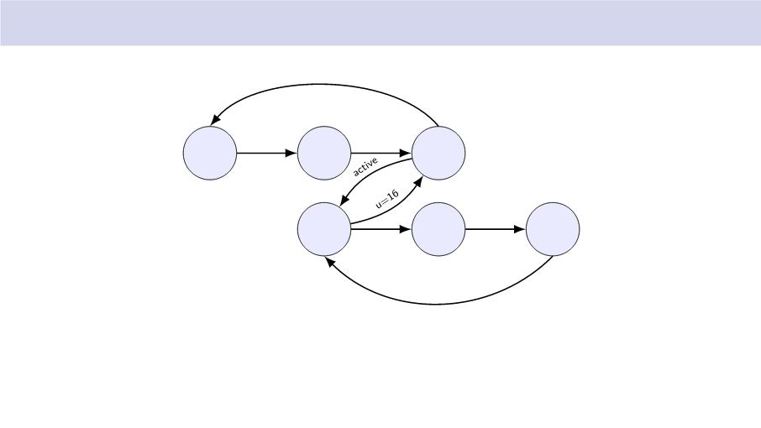
sprite_fetch — ROM read + line-bu!er ﬁll
all done
hblank
CLEAR eval_done
IDLE
BUF
PROC
READ
PIX
WAIT
PIX
WRITE
PIX
u<16
Worst-case cycle budget per scanline: CLEAR_BUF (640) + 8 sprites → 48 (384) =↑1024 cycles.
HBLANK alone is 160; HBLANK + visible is 800. Fetch lives one line behind the read, so the
ping-pong line bu!ers absorb the latency.
12/ 19

Slide 13
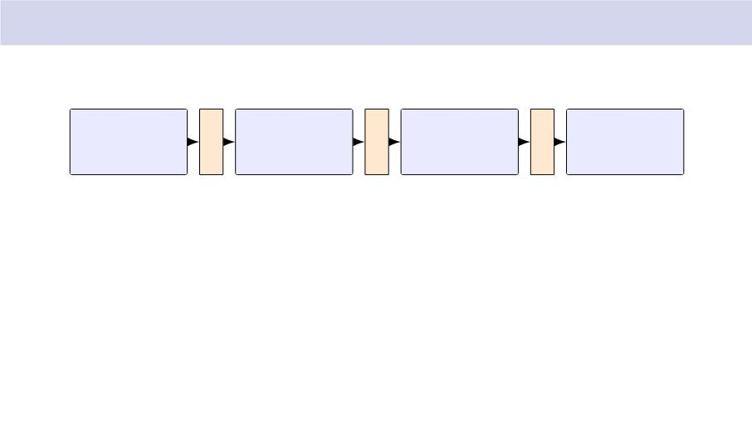
Compositor — 4-stage pipeline
S1
S2
S3
S4
region
decode
tile ROM
addr mux
palette
RGB out
index mux
HUD predicates,
HUD tile ID,
BCD digit
bg tile ROM
sprite px if = 0
HUD layer
or HUD glyph
else tile px
wins on top
Latches between stages absorb the 1-cycle latency of tile ROM and palette M10K reads. Never
stalls.
13/ 19

Slide 14
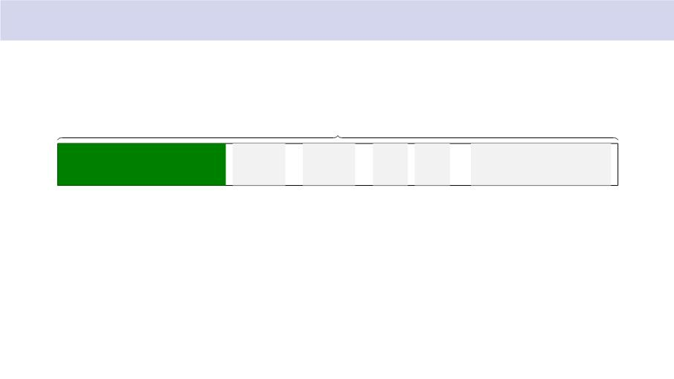
HUD strip — top 16 pixels of every frame
640 px, y = 0..15
HP bar 192px
AMMO 99
WAVE 05
ART 2 GAS 2
SCORE 000800
HP bar: 2 px per HP, clamped to 192. Glyphs: 8→8 from tile ROM, slots 16–41 (A–Z),
48–57 (0–9). Scores, ammo, wave packed BCD in registers.
14/ 19

Slide 15

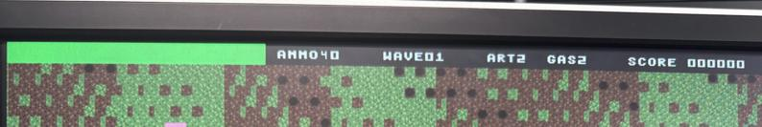
HUD — on the monitor

Slide 16
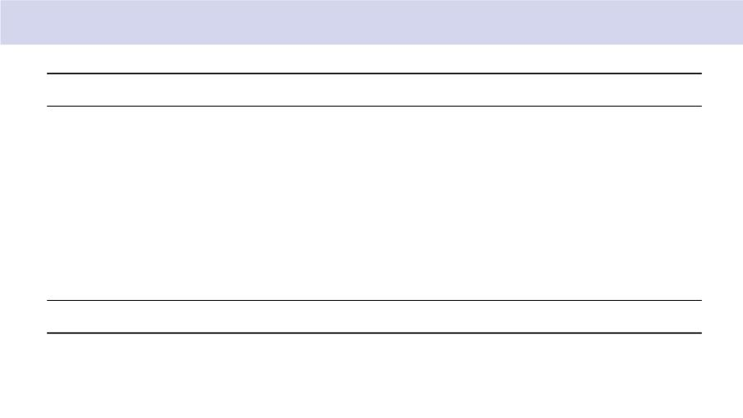
Memory inventory (all inferred M10K)
Memory
Shape
Init
Bits
sprite ROM
tile ROM
tile map
palette
16,384 → 8
4,096 → 8
$readmemh
$readmemh
131,072
32,768
38,400
6,144
2,048
2,048
1,200 → 32 (packed 4 → 8) blank (HPS writes)
256 → 24
$readmemh + HPS overrides
sprite table act. 32 → 64
sprite table shd. 32 → 64
via VSYNC bulk copy
HPS writes
cleared per HBLANK
cleared per HBLANK
line bu!er A
line bu!er B
640 → 8
640 → 8
5,120
5,120
Total
86,144 bits
14 M10K blocks out of 397.
16/ 19

Slide 17
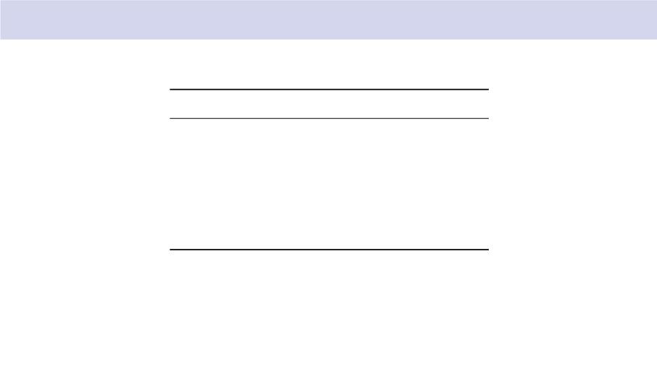
Resource utilisation — Cyclone V 5CSEMA5F31C6
Resource
Used Available
%
ALMs
Registers
Pins
205
365
54
32,070 < 1%
—
—
12%
2%
457
Block memory bits 86,144 4,065,280
M10K blocks
DSP blocks
14
0
397
87
4%
0%
Compile time: 63s wall clock (Analysis 13 s, Fitter 30 s, Asm 12 s, STA 8 s).
17/ 19

Slide 18
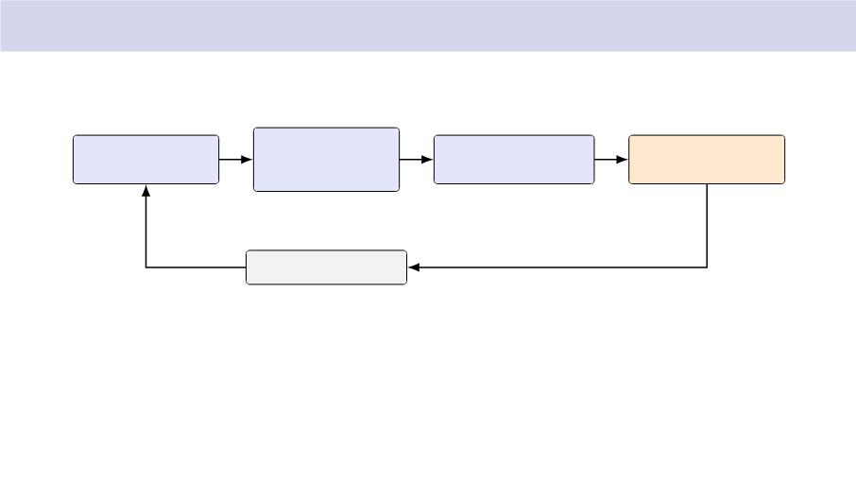
Software architecture — 60 Hz game loop on the ARM
input_read
game_tick
render_frame
nml_commit_frame
evdev poll
AI, collision
entity ↑ sprite table
set SWAP, poll
autoatk timers
nanosleep 16.67 ms
game_t holds a 64-entity pool. State machine: PLAYING ↗ LEVELUP ↑ GAMEOVER.
Mortar is timer-driven; artillery + gas ﬁre from L/R shoulders.
18/ 19

Slide 19
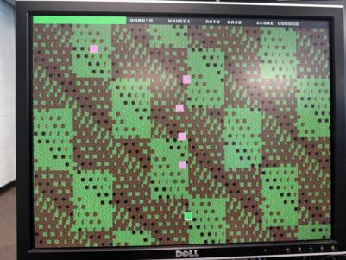
What actually works
640→480 @ 60 Hz • tile-mapped battleﬁeld • 32 hardware sprites • 256-entry palette
HUD: HP bar, AMMO, WAVE, ART, GAS, SCORE (BCD)
SNES gamepad via evdev; 60 Hz HPS game loop; frame-commit at VSYNC
Mortar, artillery, gas clouds, wave spawner, level-up, ammo drops, game-over

Slide 20


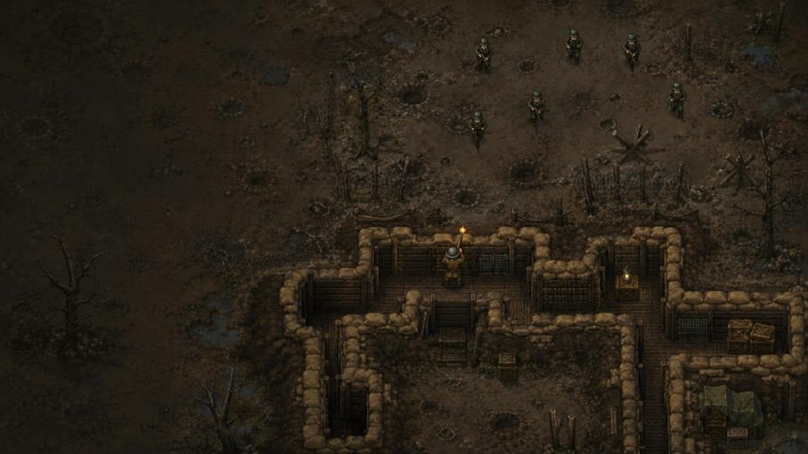

No Man’s Land
Program Deep Dive: from controller input to VGA sprite table
Focus: software program internals, data ꢀow, and hardware interface

Slide 21













What the software actually does each frame
File-level responsibilities with the real call path
wave.c
spawn schedule
input_real.c
/dev/input/
event0
main.c
frame timing
state logging
game.c
state machine
entity updates
render.c
entity → sprite
slots
nml_gpu.c
/dev/mem
register writes
→ bitmask
autoatk.c
abilities
The main separation is intentional: gameplay logic never knows whether output is terminal text or
the real FPGA.
Detailed deck: program calls and data ownership

Slide 22

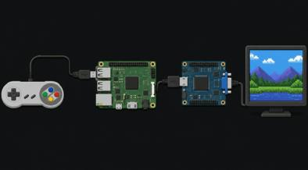






Two builds, one game core
The same game_t and game_tick() are reused
Terminal build
render_terminal.c
prints sprite slots
FPGA build
render.c + nml_gpu.c
writes registers
Shared core
main.c → input_read() → game_tick() → render_frame()
uint16_t input = input_read(game.frame);
game_tick(&game, input);
render_frame(&game);
Build-time choice: link render_terminal.c or render.c

Slide 23






The game state is just structured memory
game_t owns every object and counter
game_t
entity_t
kind
ents[64]
player_i
Entity kinds
PLAYER
frame
score / hp
active
ENEMY_ARMED
ENEMY_UNARMED
BULLET
x, y
state / prev_state
prev_input
vx, vy
hp
ENEMY_BULLET
AUTO_PROJ
wave counters
autoatks[]
phase
ttl / ttl_max
payload
1re_cd
HAZARD
ammo / charges
beam visual state
AMMO_DROP
Core invariant: inactive entity slots are available for reuse

Slide 24










main.c controls timing, not game rules
The loop handles hardware init, signals, frame duration, and debug prints
if (!NML_TERMINAL_BUILD) {
startup
nml_open();
init_palette_runtime();
render_init_tilemap();
nml_set_enable(1);
}
FPGA path maps /dev/mem and paints palette/tilemap
per-frame
while (g_running) {
input = input_read(frame);
game_tick(&game, input);
render_frame(&game);
}
input → tick → render
transitions
prints wave clear, level-up, game-over logs
shutdown
SIGINT/SIGTERM turns o@ video cleanly
main.c stays thin so gameplay remains testable

Slide 25
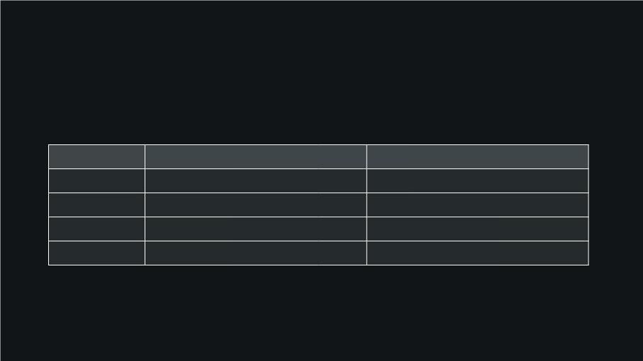








input_real.c turns Linux events into a bitmask
No game logic depends on Linux input details
/dev/input/
drain_events()
updates button_state
and axis values
axis deadzone
ABS_X/ABS_Y
→ movement bits
uint16_t
INPUT_* bits
event0
nonblocking evdev
Control
D-pad X/Y
B / Y / X / A
L / R
Linux code
ABS_X / ABS_Y
Game bit
LEFT / RIGHT / UP / DOWN
1re down / left / up / right
artillery / gas
BTN_THUMB2 / TOP / TRIGGER / THUMB
BTN_TOP2 / BTN_PINKIE
BTN_BASE4
Start
restart / con1rm path
Debug mode: NML_INPUT_DEBUG=1 prints raw events for remapping

Slide 26








game_tick() is a state machine
Most bugs are easier to locate once the state transition is clear
STATE_PLAYING
updates entities
checks wave clear
STATE_LEVELUP
cursor move
STATE_GAMEOVE
R
B con1rms
wait for Start
then game_init()
Every tick starts by saving prev_state and increments frame; prev_input is stored at the end for
edge detection.
wave_advance()
applies upgrade then resets wave counters
game_tick(): routes PLAYING vs LEVELUP vs GAMEOVER behavior

Slide 27












Player update: movement, clamps, 9ring, abilities
update_player() consumes the bitmask produced by input_real.c
Move
D-pad adds ±4 px/frame
to x/y
Clamp
x: 0..624
y: HUD_H..464
Fire
face buttons choose
axis-aligned bullet
Abilities
L: artillery
R: gas cloud
if (INPUT_FIRE_DOWN) bullet( 0, +8);
else if (INPUT_FIRE_LEFT) bullet(-8, 0);
if (fire_cooldown != 0) return;
if (ammo <= 0) return;
spawn ENT_BULLET;
else if (INPUT_FIRE_UP)
bullet( 0,-8);
fire_cooldown = 5;
ammo--;
else if (INPUT_FIRE_RIGHT) bullet(+8, 0);
Cooldown prevents multi-button 1ring from spawning four bullets in one frame

Slide 28










Enemy AI is simple but intentionally de-synchronized
Armed enemies add 1re behavior on top of movement
Vertical pressure
e->y steps toward player row
at wave speed
Horizontal choice
25% left, 25% right,
Armed 9ring
cooldown counts down
then aims once
50% chase player
r = enemy_rng(frame, phase)
dx = player.x - enemy.x
dy = player.y - enemy.y
norm = |dx| + |dy|
phase = rand() & 0xff
fire_cd = 60 + rand()%120
// avoids synchronized waves
if r < 64:
elif r <128: x += speed
else: x → player.x
x -= speed
v = 3 * (dx,dy) / norm
Enemy bullets are not homing; they lock direction at spawn time

Slide 29








Motion updates are separate from collision handling
Each entity type has one simple update rule
Player bullet
x += vx, y += vy
despawn o@-screen
Enemy bullet
same motion path
damages player later
Ammo drop
ttl-- until 0
collected by AABB
Beam
beam_ttl controls
tile column
This separation keeps behavior predictable: movement 1rst, then a single collision pass
resolves consequences.
ate_enemies(); update_bullets(); update_enemy_bullets(); update_ammo_drops(); autoatk_tick(); autoatk_update_proj(); handle_collisions
No collision is applied during the motion loops

Slide 30















Collision handling is ordered by gameplay meaning
handle_collisions() owns damage, pickups, and score bookkeeping
1
2
3
4
5
Ammo drop
Enemy bullet
Enemy
player
player
ammo += 10, cap at 99, drop disappears
player HP −10, bullet disappears
player
player HP −10, enemy disappears, no score
bullet disappears, apply_damage(enemy, 1)
damage + optional despawn policy by weapon kind
Player bullet
enemy
Auto hazard/projectile
enemy
All enemy kills route through apply_damage() so score, kill counters, and ammo drops stay consistent.
AABB is 16×16 for normal entities; gas uses size-aware overlap

Slide 31
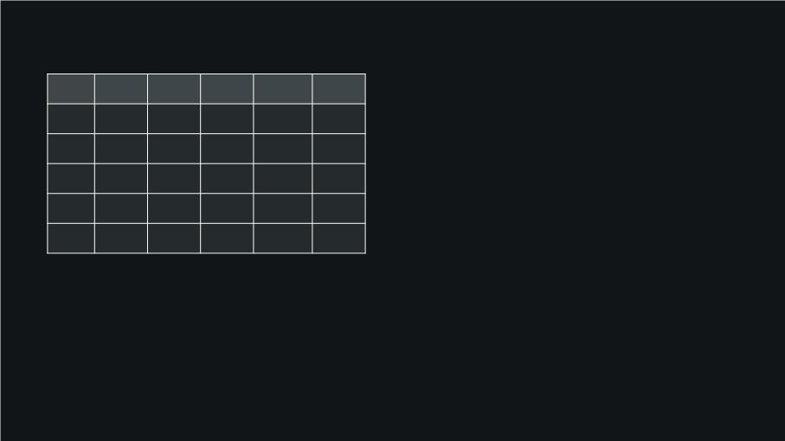





wave.c is a data-driven spawner
DiPculty lives in the WAVES table
Wave
period
60
total
6
armed
armed HP
speed
wave_tick()
spawn when cooldown hits zero
1
2
0
1
2
4
6
1
2
2
2
3
1
1
2
2
3
50
8
alloc_entity()
1nd inactive entity slot
3
45
10
12
16
4
35
initialize enemy
kind, hp, phase, 1re_cd
5+
25
wave_complete()
spawned all + none alive
Wave 5 clamps and repeats as the hardest pattern

Slide 32










Level-up pauses the simulation before advancing the wave
The upgrade menu is still part of game_tick()
wave_complete()
PLAYING → LEVELUP
pick options
3 auto-attack choices
B con9rms
upgrade + wave_advance
if LEVELUP:
LEFT/RIGHT moves cursor
B confirms option
wave_advance():
wave_index++
reset spawn counters
refill ammo/charges
autoatk_upgrade(kind)
Important detail: wave_advance() happens after the player picks an upgrade, not immediately
when the wave ends.
Level-up is not a separate program; it is a game state

Slide 33











render.c converts entities into hardware sprite slots
This is the bridge from gameplay state to VGA-visible objects
slot 0
always player
slots 1–31
entities in array order
gas hazard
expands into 1–4 sprites
leftover slots
nml_hide_sprite()
emit_sprite(&slot, e->x, e->y,
entity_to_sprite_id(e),
entity_palette_off(e),
priority);
Mock renderer mirrors this ꢀow but prints slot contents instead of writing registers

Slide 34
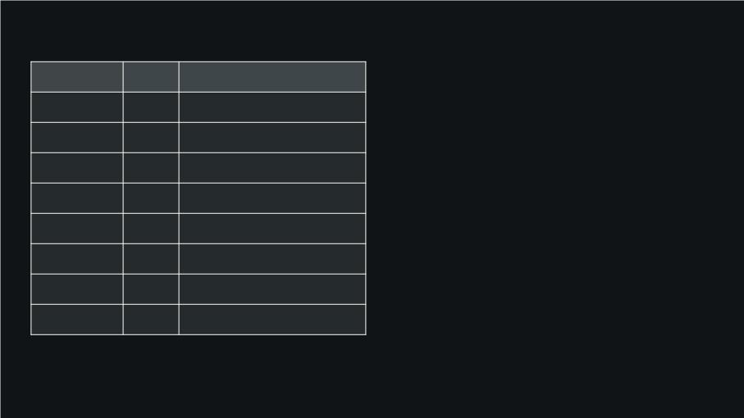





nml_gpu.c packs C structures into Avalon register writes
The program writes a 16 KB LW bridge window mapped at 0xFF200000
Region
ODset
0x0000
0x0010
0x0014
0x0018
0x0020
0x0100
0x0400
0x1000
Write meaning
ENABLE / SWAP / HUD_ON
x and y packed into one word
hp + BCD wave + level
HUD score
nml_open()
open("/dev/mem") → mmap(NML_LWFPGA_BASE)
CTRL
PLAYER_POS
PLAYER_STATS
SCORE
nml_write_sprite()
W0 = y:x, W1 = sprite_id:ꢀags:palette_o@
HUD_AUX
SPRITE_TABLE
PALETTE
ammo + artillery + gas charges
32 × 8-byte sprite entries
RGB888 entries
nml_commit_frame()
sets CTRL.SWAP so hardware commits at VSYNC
TILEMAP
80 × 60 tile IDs
Register packing matches nml_gpu.h and the design document

Slide 35
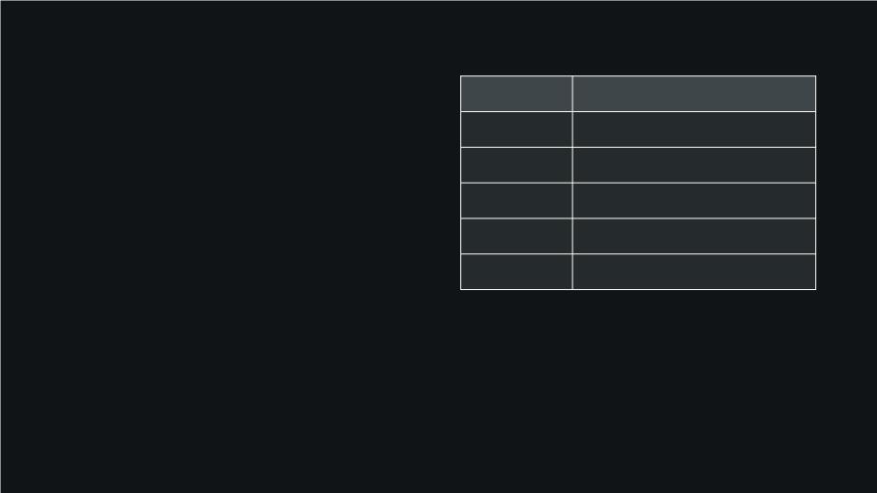






One sprite slot is two 32-bit words
This is what render.c ultimately writes per visible object
Field
Purpose
W0: position
sprite_id
ACTIVE
selects 16×16 art in sprite ROM
visible / hidden
bits 15:0 = x
bits 31:16 = y
priority
scanline culling order
future sprite mirroring
recoloring hook
W1: identity + draw Eags
sprite_id, ꢀip bits, priority, active, palette o@set
hꢀip / vꢀip
palette_o@
w0 = ((uint32_t)(uint16_t)y << 16) | (uint16_t)x;
w1 = sprite_id | (flags << 8) | (palette_off << 16);
render.c never writes pixels; it writes sprite descriptors for the FPGA compositor

Slide 36








render_terminal.c is a diagnostic mirror of render.c
It helps verify slot allocation before touching the FPGA
mock_sprite_t
active, x, y, sprite_id, glyph
entity_glyph()
P, A, u, *, ^, +, M, ~
slot printout
frame, hp, score, wave, ammo, 32 slots
frame=150 hp=100 score=0 sprite_count=3
slot 00: sprite_id=1 x=320 y=420 glyph=P
slot 01: sprite_id=2 x=320 y=115 glyph=A
slot 02: sprite_id=4 x=53 y=55 glyph=u
slot 03: inactive
If terminal slots look wrong, FPGA output will also be wrong

Slide 37
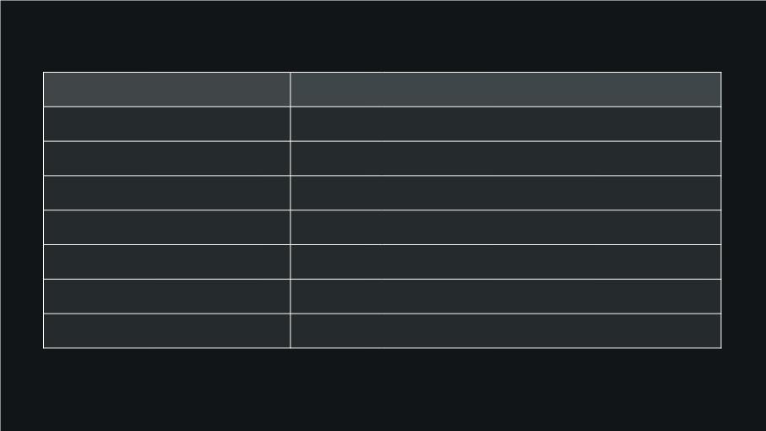
Where to debug when something goes wrong
Symptoms map to speci1c 1les
Symptom
controller moves nothing
player moves but cannot 1re
enemies sync into columns
wave never ends
First place to look
input_real.c: event device, mapping, permissions
update_player(): ammo + 1re_cooldown
phase / enemy_rng() in update_enemies()
wave_complete(): spawned count + active enemies
render.c: hide leftover slots
sprites ghost on screen
FPGA shows blank
nml_open(), CTRL.ENABLE, palette/tilemap init
nml_set_player_state(), nml_set_score(), HUD_AUX
HUD wrong
Testing strategy: verify terminal build 1rst, then the hardware writer

